Slide 1
Impaired-driving detection using multi-sensor Data
Presented by: Vishaka Sharma | MIS 6940 | Oakland University

Slide 2

Executive Summary
Alcohol and fatigue impairment remain major safety risks for transportation.
We captured real multi-sensor driving data across four impairment levels using a driving simulator, breathalyzer, and ECG sensors.
Goal: Identify which driver behaviors and physiological signals most reliably predict impairment, and whether ML models can detect high-risk states in real time.

Slide 3




Industry Context: Why Our Research Matters
The landscape of driving safety is rapidly evolving, driven by significant investments and regulatory pushes from key industry players. This study directly addresses these emerging needs.
Automotive OEMs
Insurance Companies
Investing in advanced Driver Monitoring Systems (DMS) for drowsiness, alcohol, and lane departure detection to enhance vehicle safety and driver assistance.
Seeking behavior-based risk scoring models to personalize premiums, incentivize safer driving, and mitigate accident liabilities.
Regulators (NHTSA)
Project's Impact
Actively advocating for and developing the Driver Alcohol Detection System for Safety (DADSS) to prevent alcohol-impaired driving fatalities.
Provides crucial, quantifiable evidence and predictive models to validate and accelerate the adoption of these life-saving technologies across the industry.

Slide 4
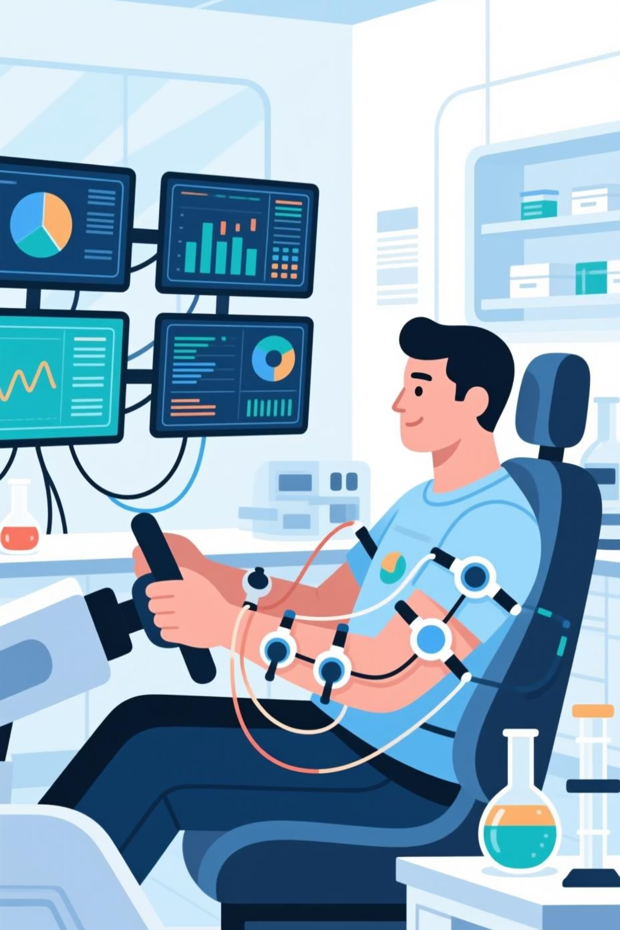
Study Design: Phase 1 & 2 Overview
Our research methodology was structured into two distinct phases, carefully designed to ensure data integrity and comprehensive measurement of impairment indicators.
01
Phase 1: Eligibility & Screening
437 interested → 267 qualified → 106 completed
Screened for motion sickness, health issues, alcohol constraints
02
Phase 2: Driving + Sensors
4 driving trials per participant (Levels 1–4)
Level 1 - Baseline
Level 2 - Low impairment
Level 3 - Moderate
Level 4 - High impairment
Simulator + Breathalyzer (BAC) + Sleepiness (KSS) + ECG + Head/Face Tracking

Slide 5





Data Sources & Variables
Our comprehensive study captured a wide array of data points to provide a holistic view of driver behavior and physiological responses under varying conditions.
Driving Behavior (SIM)
Physiological Sensor (ECG)
Subjective Alertness
Steering, speed, throttle, brake
Heart activity signal
KSS (Karolinska Sleepiness Scale)
Alcohol Level
Demographics
BAC
Age, gender, and other background information

Slide 6
Impairment Detection Dashboard

Slide 7

Statistical Findings (Correlation + Descriptive Trends)
Our analysis revealed key statistical correlations and descriptive trends that highlight the impact of impairment on driver behavior and physiology.
BAC Value & Speed Changes
Steering Behavior as Indicator
Breath Alcohol Content (BAC) values showed a direct correlation with Karolinska Sleepiness Scale (KSS) scores and significant changes in speed variability.
Standard deviation in steering wheel angle proved to be the most sensitive behavioral indicator for detecting different levels of driver impairment.
Impairment & Speed Control
ECG Variability
As impairment levels increased, the standard deviation of speed decreased, indicating a "sloppy" driving pattern with less precise speed adjustments.
Electrocardiogram (ECG) data, specifically its standard deviation, exhibited moderate but notable variations correlating with rising impairment levels.

Slide 8
Regression Insights
Which factors most significantly predict driver impairment and the limitations of our current models.
Model
Key Finding
Model 1
Breath Alcohol Content (BAC) is a statistically significant predictor of impairment (p < 0.05).
Model 2
Karolinska Sleepiness Scale (KSS) adds no significant predictive power when combined with BAC.
Model 3
A multimodal model, incorporating both physiological and behavioral data, slightly increases overall predictive accuracy (R²), though still at a low level, suggesting room for further refinement.
These findings underscore the potent impact of alcohol, while highlighting the need for more nuanced physiological and behavioral markers to detect other forms of impairment effectively.

Slide 9
Machine Learning Results: Unveiling Predictive Power
Our machine learning models demonstrate promising capabilities in predicting impairment, with Random Forest showing the strongest performance and identifying key indicators.
Model Performance Comparison
Top Features Driving Impairment (Random Forest)
BAC_value (Blood Alcohol Content)
Model
Accuracy
AUC
Throttle_mean (Average throttle input)
Logistic Regression
0.852
0.920
Speed_mean (Average driving speed)
KSS_score (Karolinska Sleepiness Scale)
Random Forest
0.870
0.912
ECG_std (ECG signal variability)
Decision Tree
0.826
0.819

Slide 10
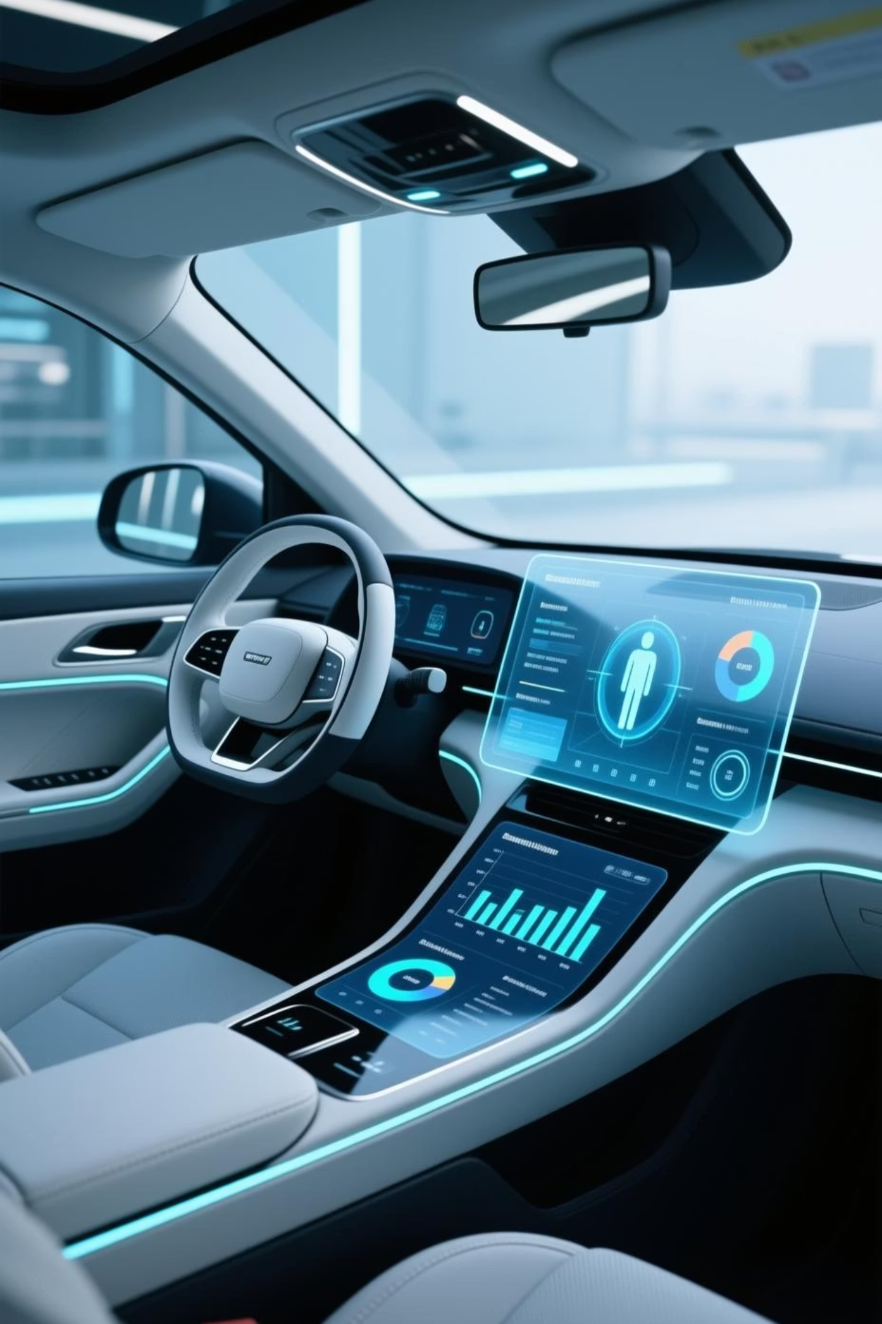
From Understanding Behavior to Predicting Impairment
Our research provides a critical bridge from theoretical understanding to practical application, enabling proactive safety measures and advanced driver monitoring.
1
Next-Gen DMS
Facilitates the design of highly effective Driver Monitoring Systems (DMS) for early impairment detection.
2
Broad Applicability
The framework is directly applicable for OEM ADAS teams, insurance risk scoring, and fleet management.
3
Regulatory Compliance
Supports regulatory efforts by providing robust, data-driven evidence for compliance and policy development.
4
Integrated Safety
Multimodal pipelines can be seamlessly embedded within future smart vehicles for real-time safety interventions.
“These findings translate directly into deployable safety systems that reduce liability, improve road safety, and support regulatory compliance.”

Slide 11
Lessons Learned & Future Work
Lessons Learned
Future Work
Data cleaning massively impacts model reliability, highlighting the importance of robust preprocessing.
Conduct real-road driving validation to test model efficacy in natural environments.
Increase participant numbers to enhance generalizability and robustness of findings.
Physiological sensors are highly sensitive to noise, requiring advanced filtering techniques.
Explore deep learning models for advanced time-series signal analysis.
Visualization proved crucial in interpreting subtle behavioral shifts and patterns.

Slide 12
References
Driver Alcohol Detection System for Safety (DADSS). (2020). National Highway Traffic Safety Administration. https://www.nhtsa.gov
Hartman, R., Huestis, M. A., Brown, T. L., & Stout, R. (2019). Alcohol effects on driving performance. Journal of Safety Research, 69, 157–165.
International Organization for Standardization. (2019). ISO 20077-1: Road vehicles — Extended vehicle (ExVe) methodology — Part 1: General information.
Bitbrain. (2021). Wearable physiological sensor specifications. https://www.bitbrain.com
Pedregosa, F., Varoquaux, G., Gramfort, A., Michel, V., Thirion, B., Grisel, O., … Duchesnay, É. (2011). Scikit-learn: Machine learning in Python. Journal of Machine Learning Research, 12, 2825–2830.

